Slide 1
Cloud Resource Usage and Cost Optimization

Slide 2
Introduction
Cloud Resource Usage and Cost Optimization Analysis
Cloud computing provides computing resources such as VMs, CPU, memory, storage, and network.
Organizations use cloud services from providers such as AWS, Azure, and Google Cloud.
Using more resources than required can increase cloud costs.
SQL can be used to analyze resource usage, compare costs, and identify underutilized resources.
This project focuses on finding opportunities to reduce unnecessary cloud expenses.

Slide 3
Problem Statement
Cloud resources may be overused or underutilized.
Unnecessary usage can increase cloud costs.
It is important to identify high-cost and low-utilization resources.
SQL can help analyse these resources and find cost-saving opportunities.

Slide 4
Objectives
Analyse cloud resource usage
Compare cloud providers and regions
Identify high-cost resources
Find underutilized resources
Suggest cost optimization opportunities

Slide 5
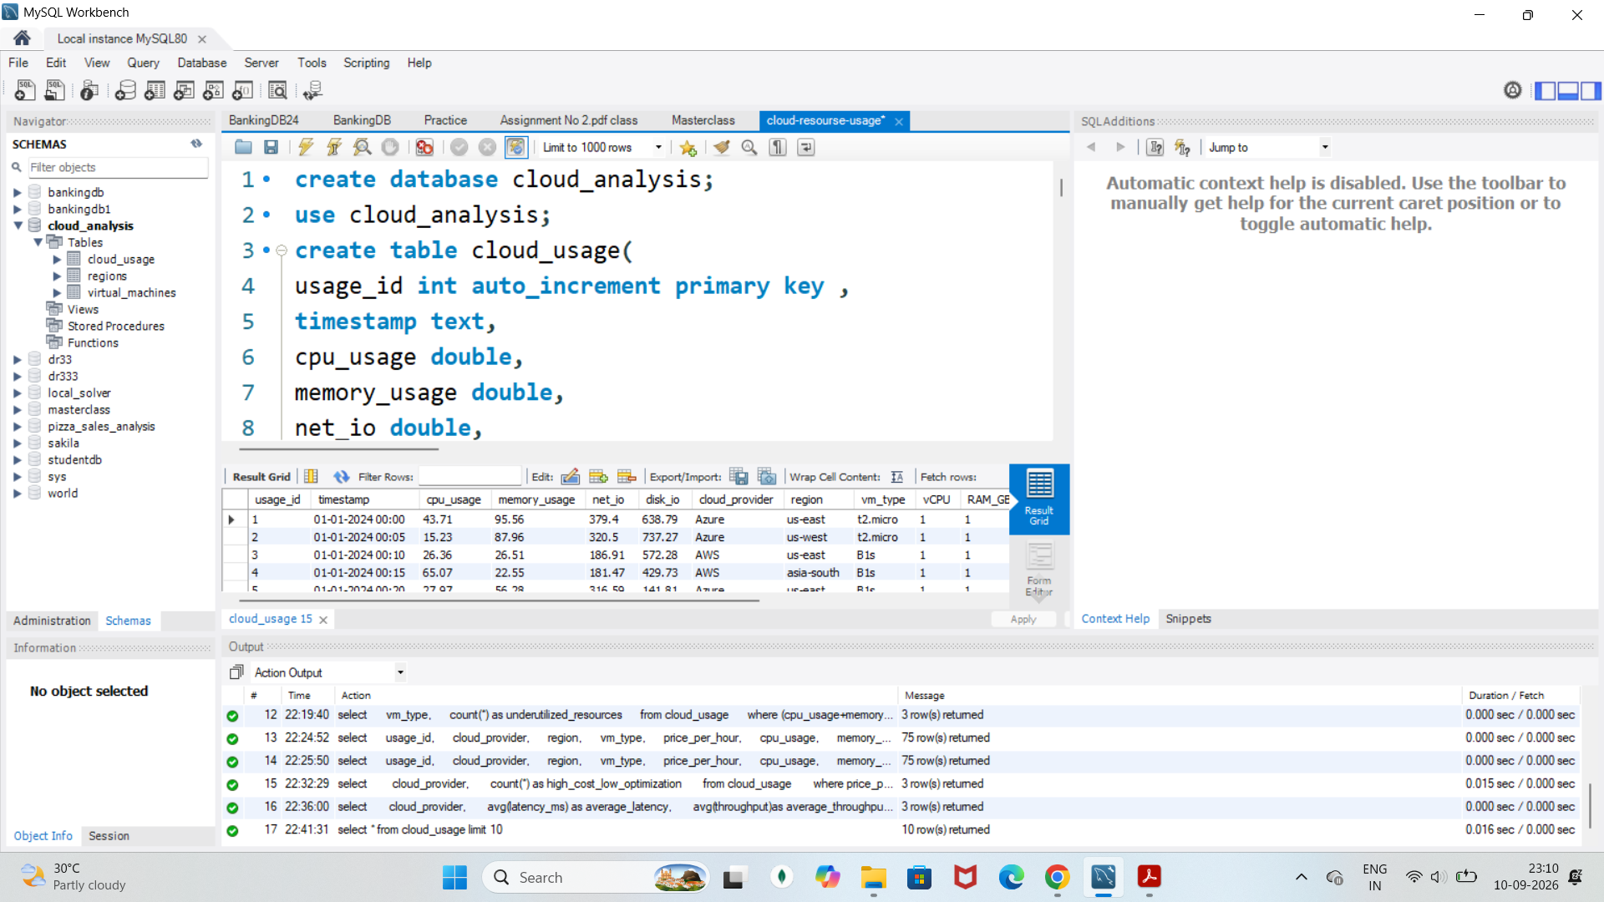
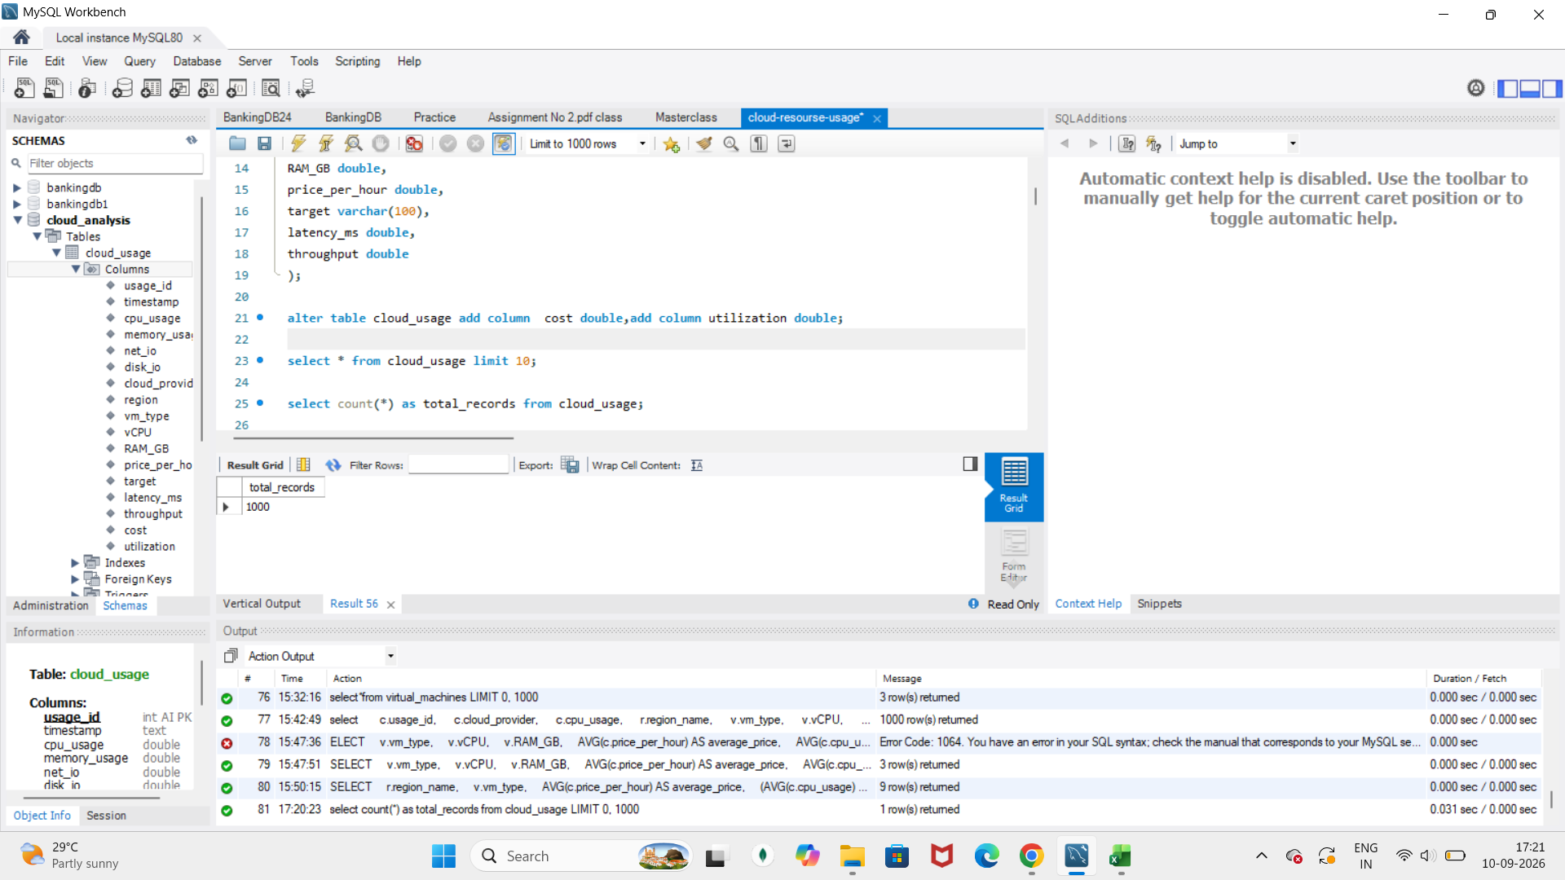
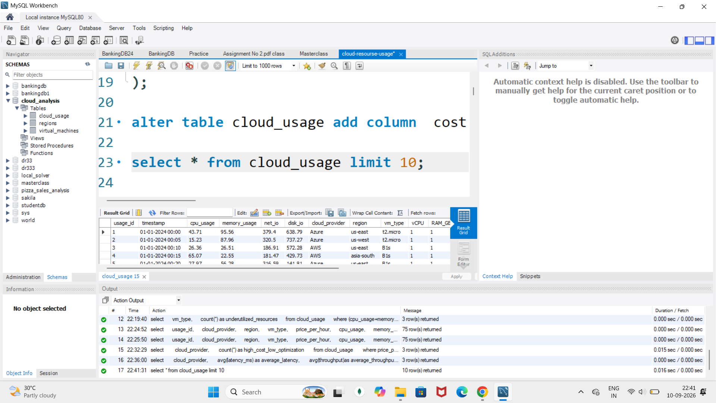
Dataset check
Database:Cloud Analysis
Total Records - 1000
Columns:15
Main Table:Cloud_Usage
Data Type:Cloud resource usage data

Slide 6
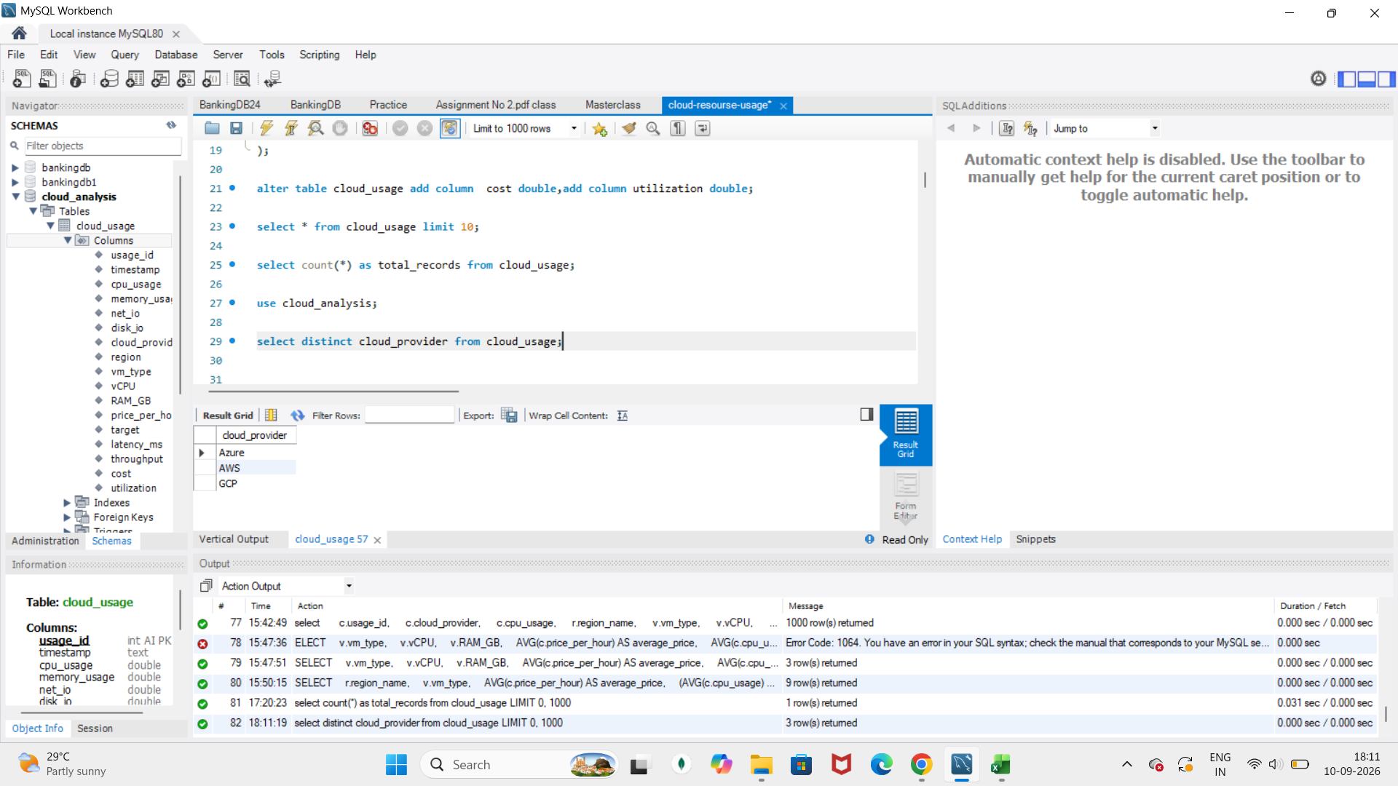
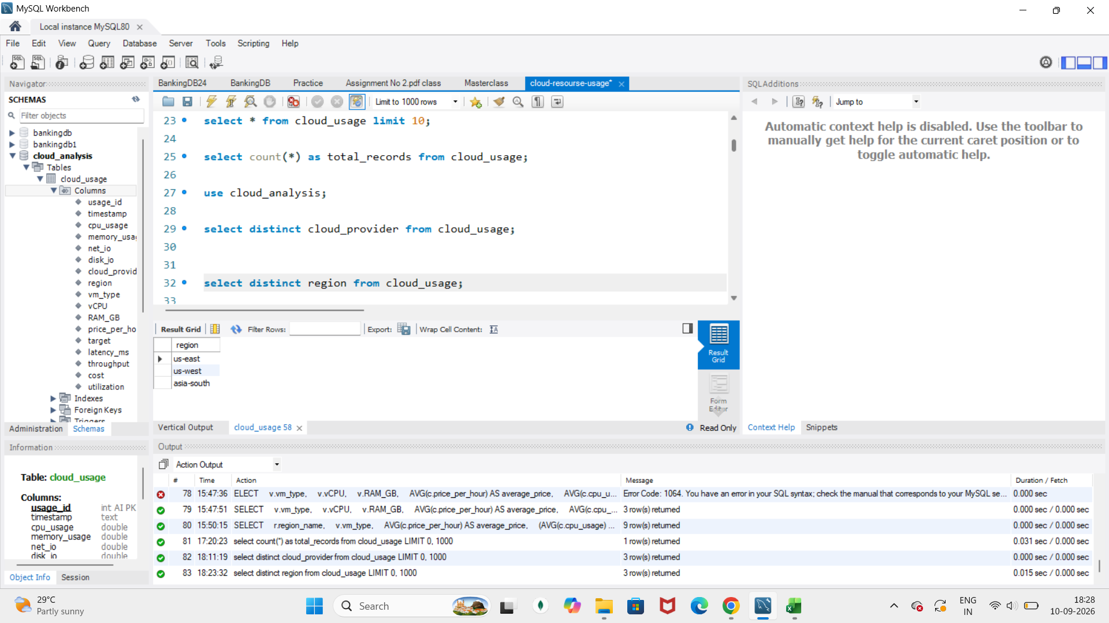
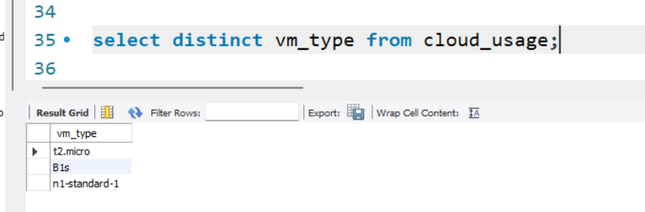
Initial Resource Usage Analysis
Identified available cloud providers
Identified available regions
Identified available VM types

Slide 7
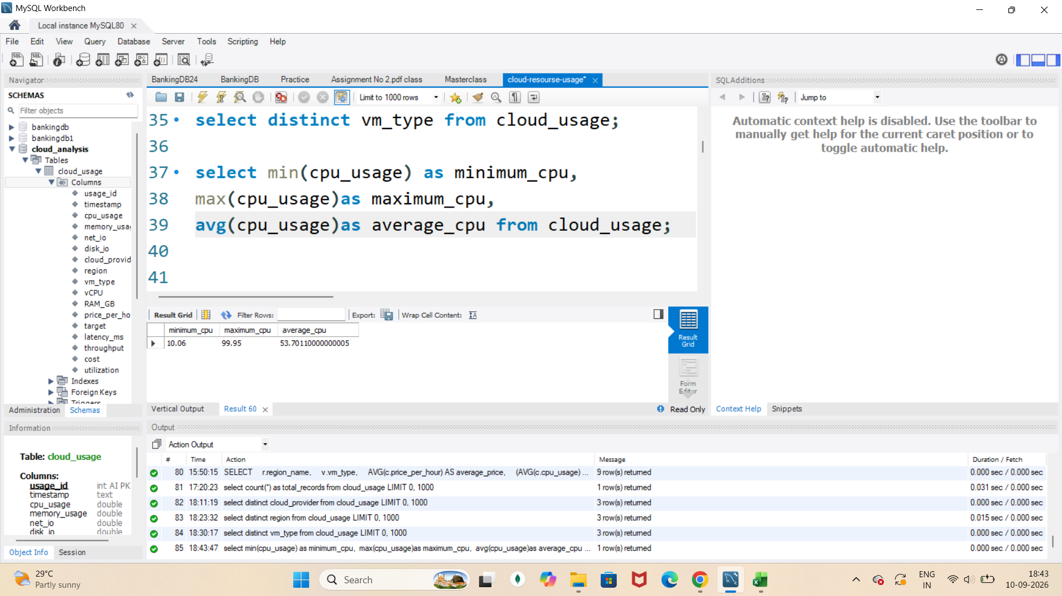
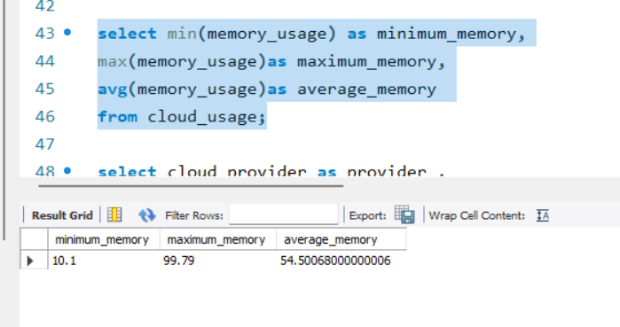
Aggregate Functions
Analysed the minimum, maximum and average CPU and memory usage of cloud resources.

Slide 8
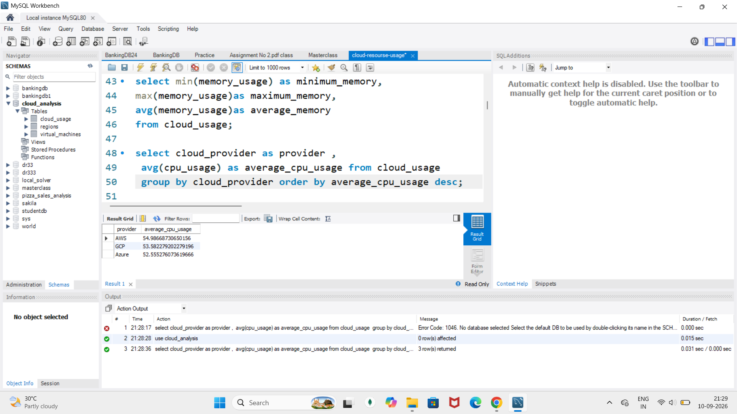
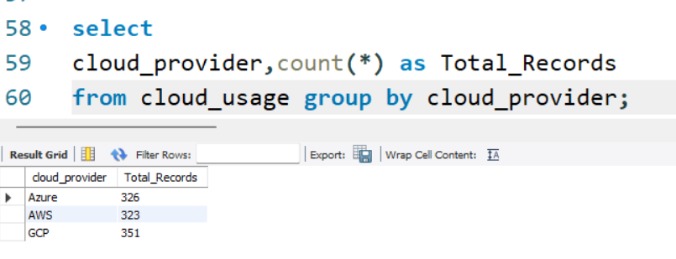
Provider Analysis
Average CPU usage by provider
Number of records by Provider

Slide 9
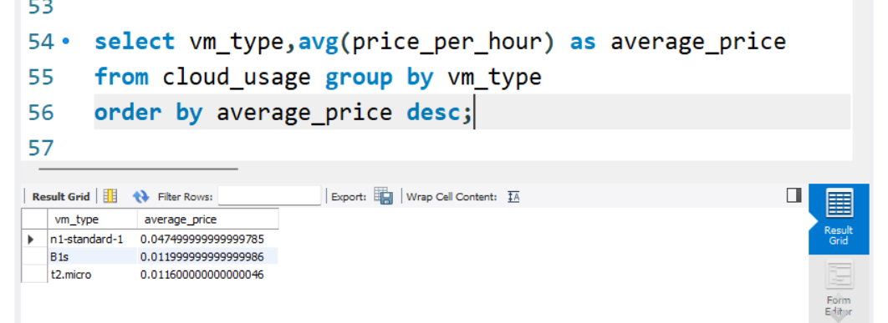
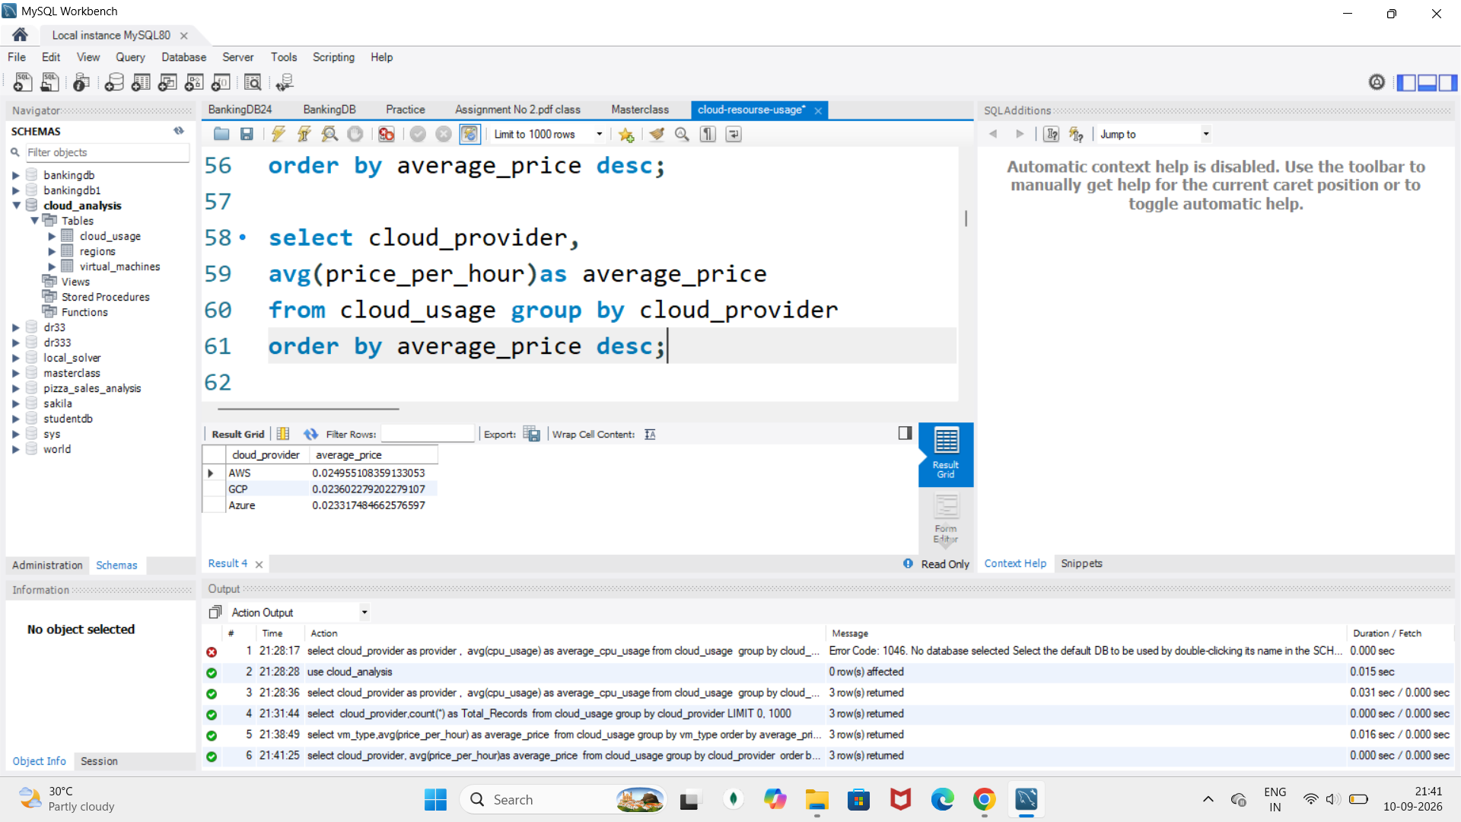
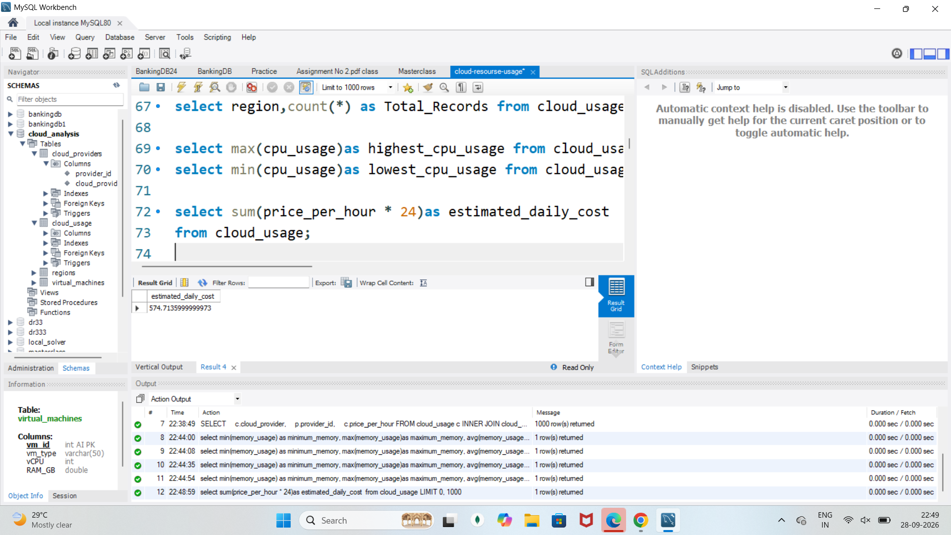
Cost Analysis
Average Price by VM type
Average price by provider
Estimated daily cost

Slide 10
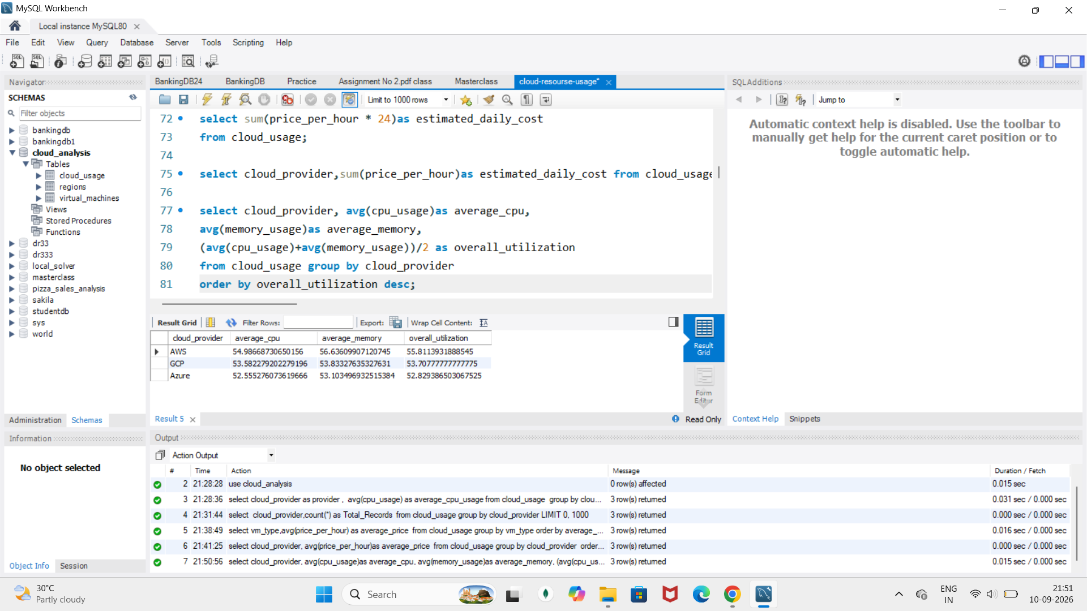
Utilization Analysis
Provider utilization

Slide 11
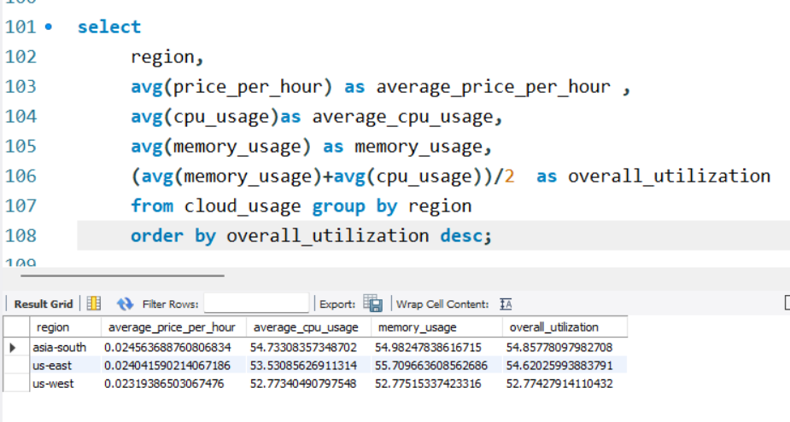
Region Analysis
Finding:
asia-south has the highest average utilization.
asia-south also has the highest average price.
us-west has the lowest average price and utilization.

Slide 12
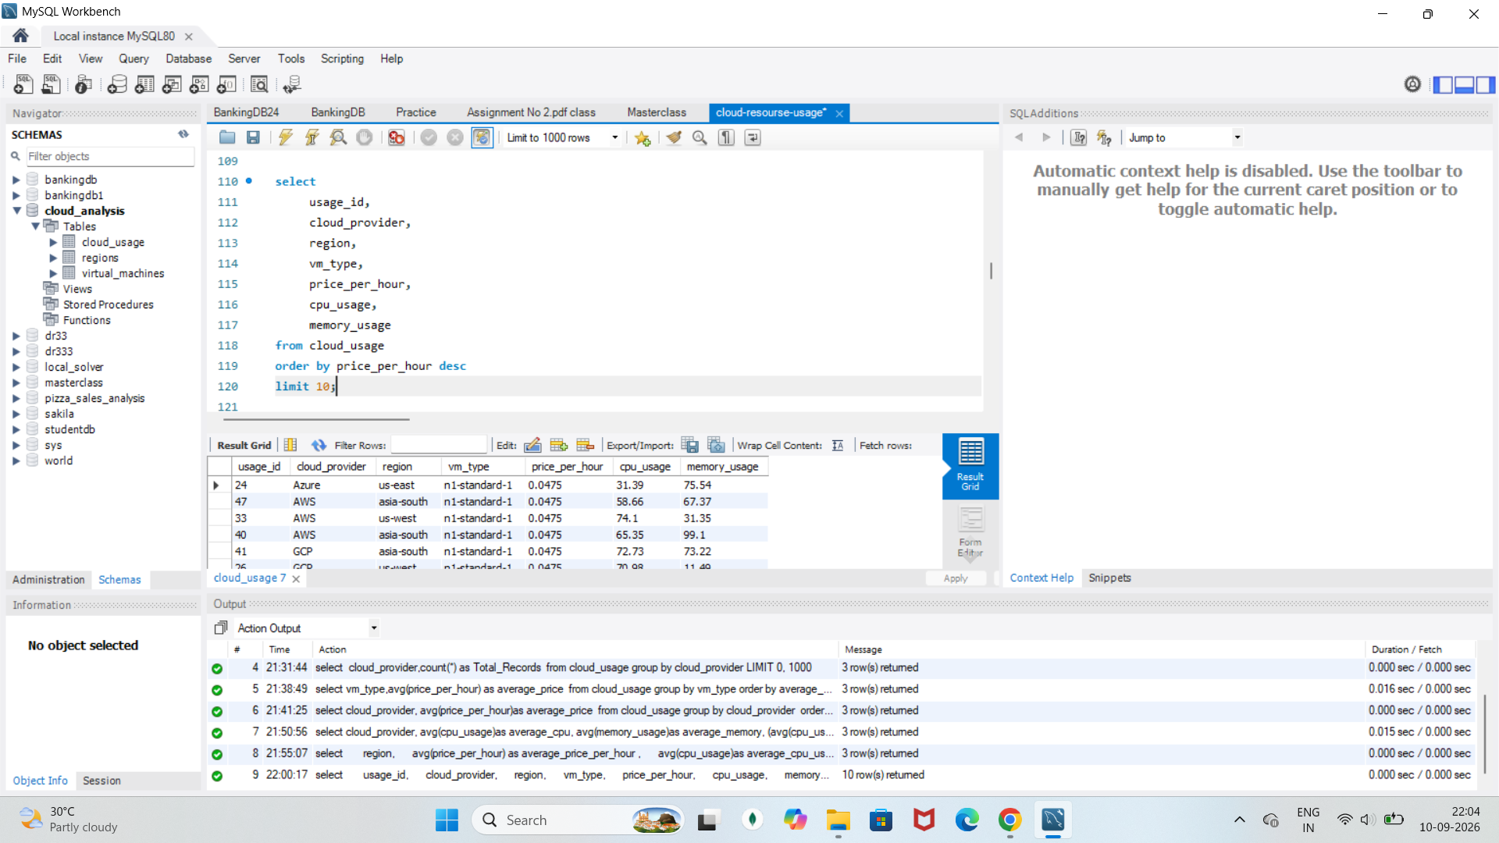
Top Expensive Resources
Finding:
The top 10 highest-price records are all from the n1-standard-1 VM type

Slide 13
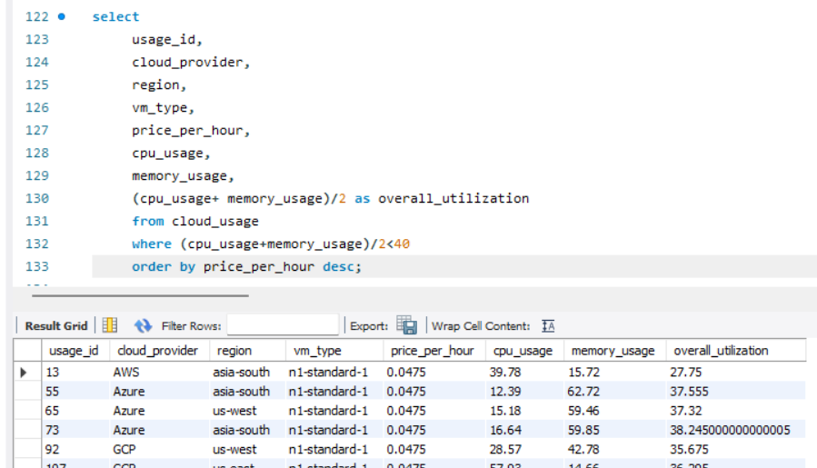
Underutilized Resources
Threshold used:Less Than 40%
Finding:
Several resources have utilization below 40% while still having an hourly cost

Slide 14
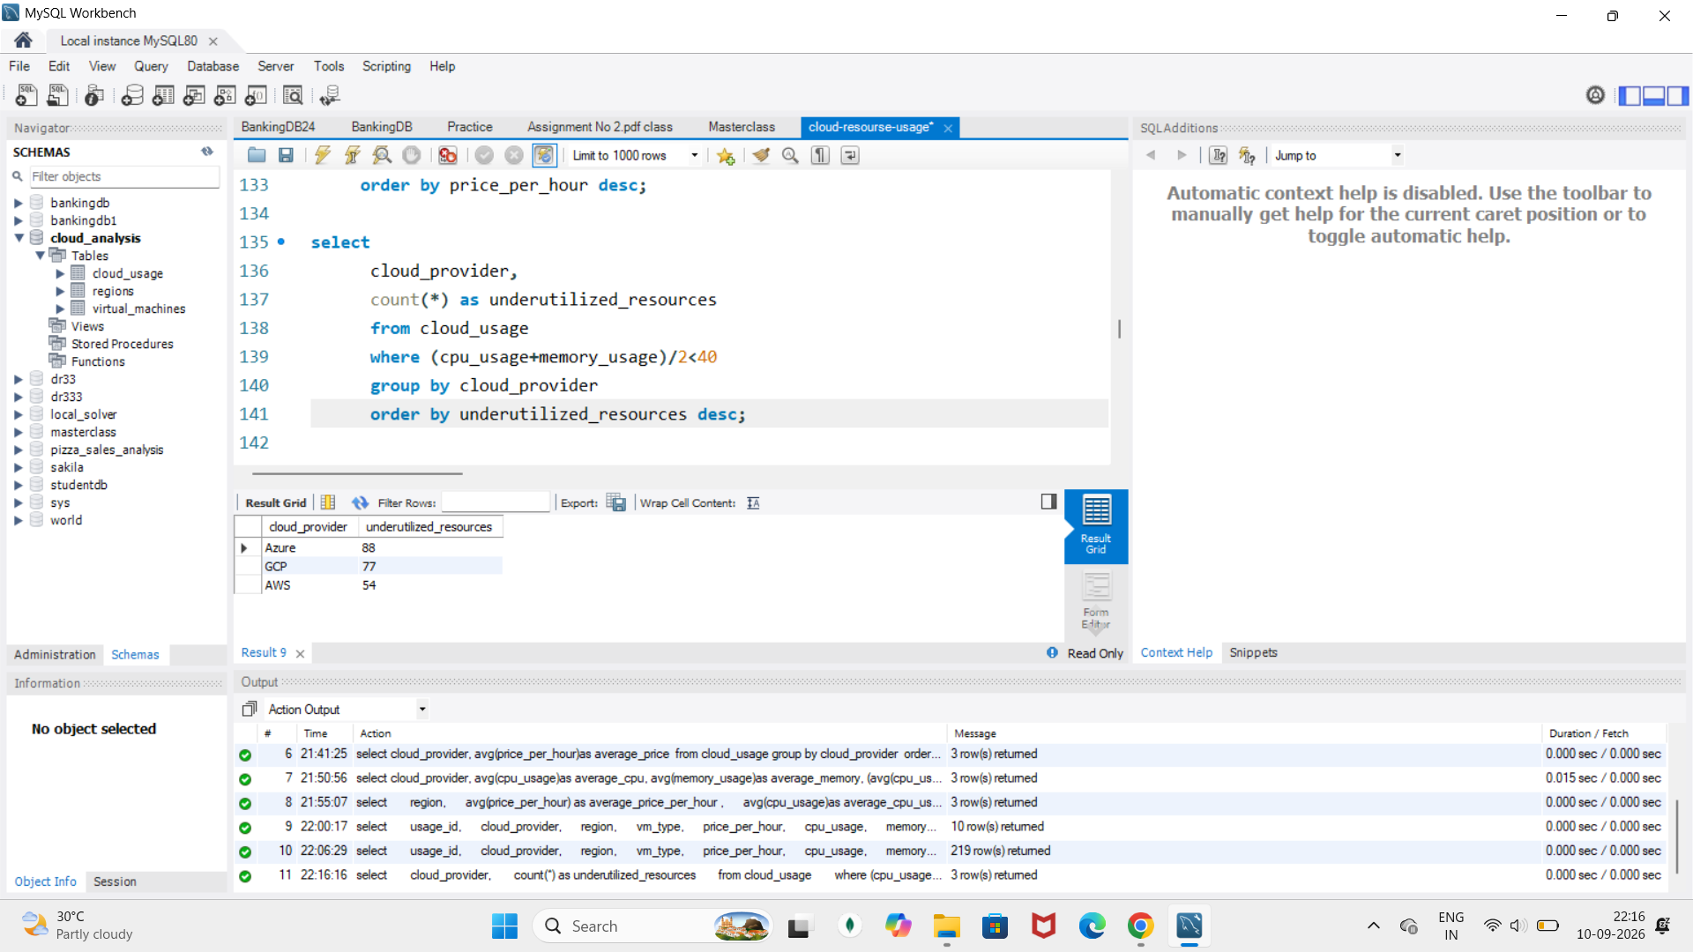
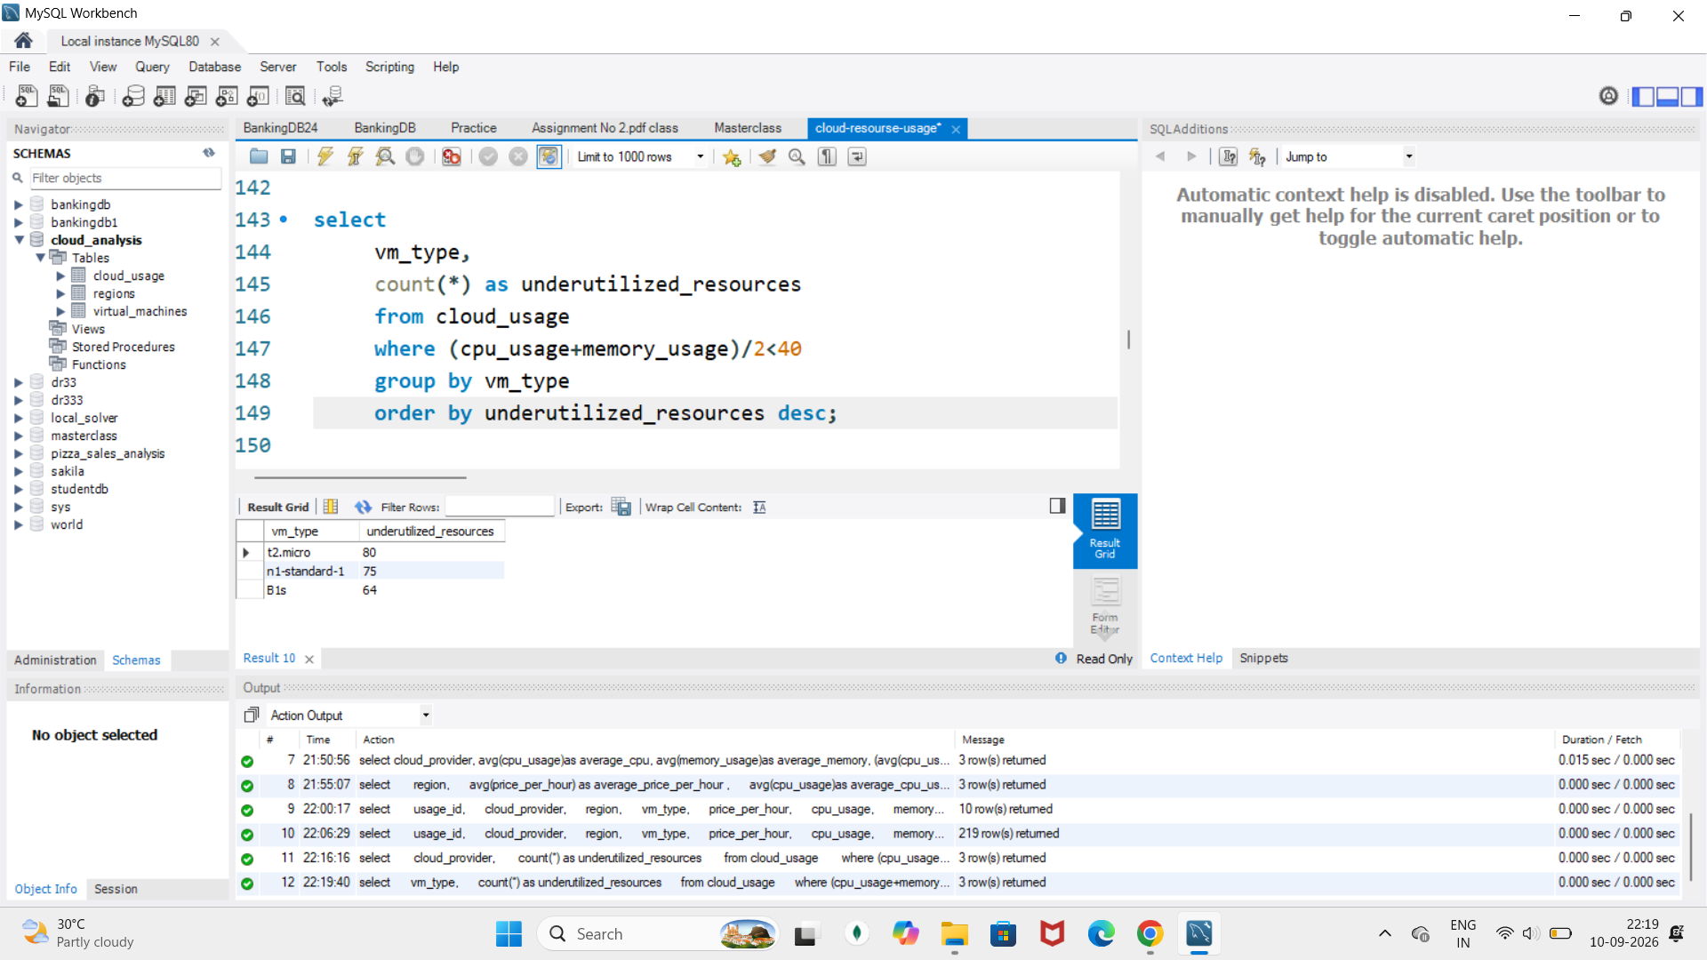
Underutilized by Provider & VM
Finding:
Azure has the highest number of underutilized records
t2.micro has the highest number of underutilized records.

Slide 15
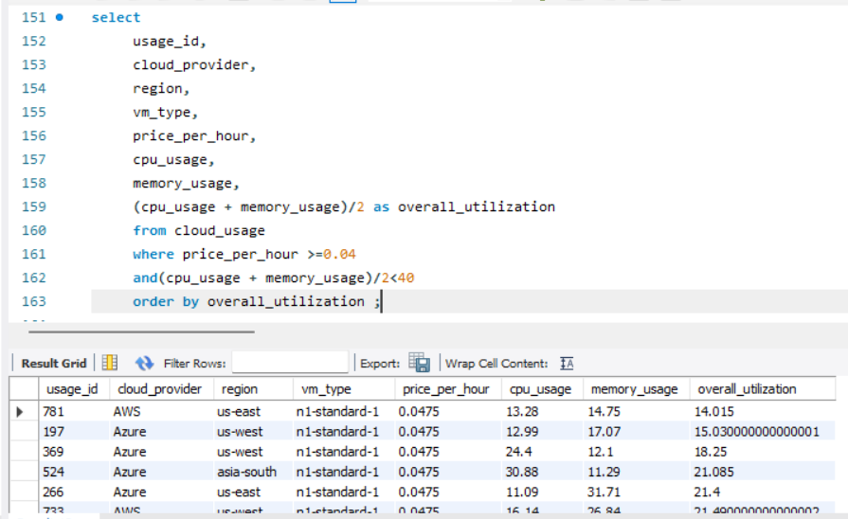
High Cost + Low Utilization
Finding:
Several n1-standard-1 resources have:
High hourly price
Low resource utilization

Slide 16
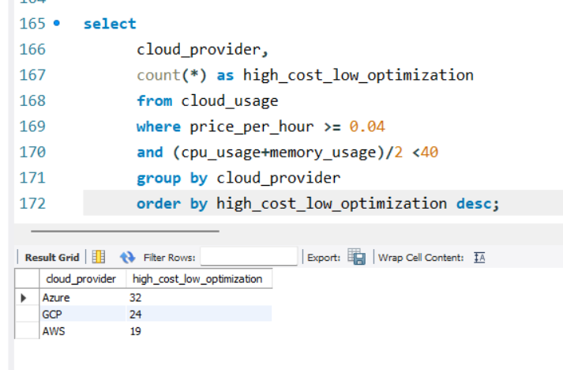
High Cost + Low utilization by provider
Finding:
Azure has the highest number of high-cost,low utilization records -32

Slide 17
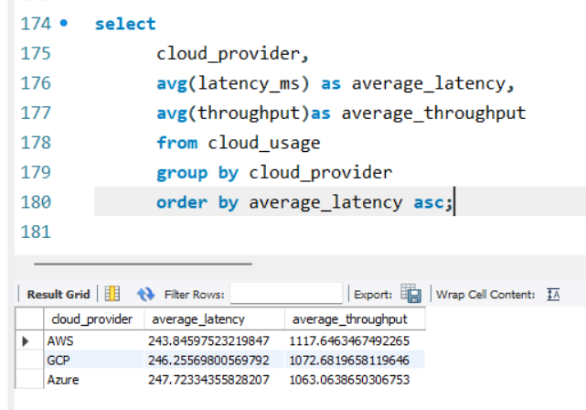
Performance Analysis
Finding:
AWS has the lowest average latency and highest average throughput in the dataset

Slide 18
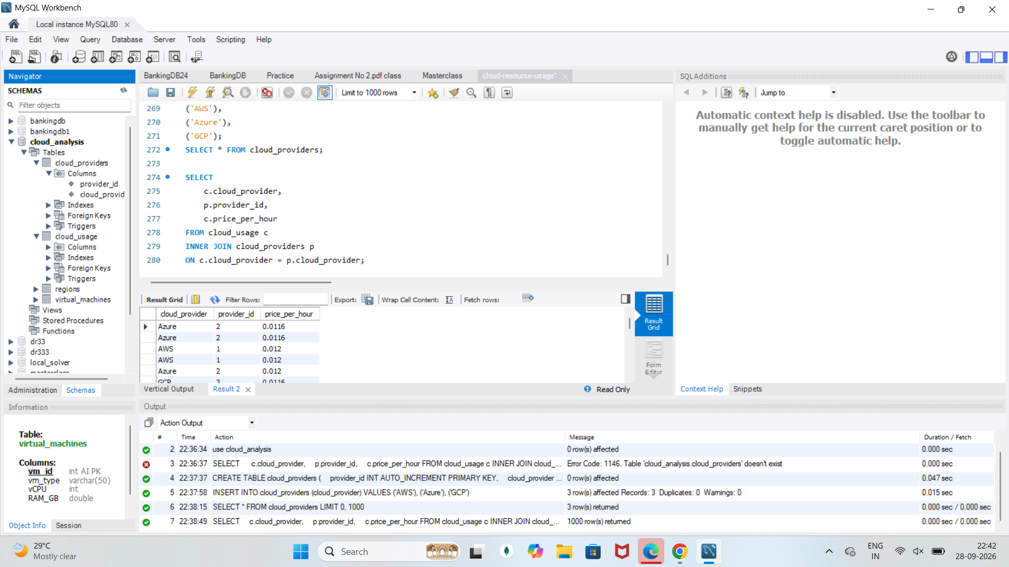
Joins
I created a separate cloud_providers table and used INNER JOIN to connect it with my main cloud_usage table using the common cloud_provider column. This allows me to combine provider information with the resource pricing data.

Slide 19
Key Findings
AWS has the highest average price per hour.
Azure has the lowest average price per hour.
AWS has the highest average resource utilization.
n1-standard-1 is the most expensive VM type.
B1s has the highest average utilization.
Some resources have utilization below 40%.
Azure has 32 high-cost, low-utilization records.
AWS shows the best network performance based on latency and throughput.

Slide 20
Conclusion
This project demonstrates how MySQL can be used to analyze cloud resource usage, cost and performance.
SQL queries helped compare cloud providers, regions and VM types.
The analysis identified high-cost and underutilized resources.
These findings can help organizations identify possible opportunities for cloud cost optimization.

